Slide 1
Tame your Data; Create {more human} Experiences.
<name>
<title>
<organization>

Slide 2

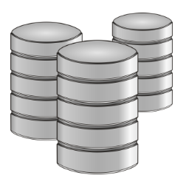


Data Science: Using data to make decisions that Drive Action
Domain Expertise
Data
Science
Data Scientists = High median salaries and average +16% bonus role change
McKinsey: “50-60% gap in data science career supply/demand by 2018 in US alone”
Code/Computing Expertise
Math/Statistics

Slide 3
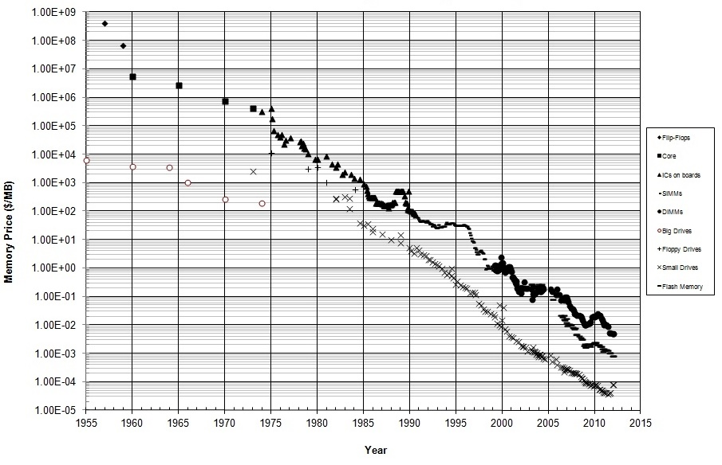
Computing Power versus Data Growth
Moore’s Law: transisters {computing power} will double every 18 months
Data growth: Doubling every 12 months
IBM: “IoT devices will double data every 12 hours”
Notes:
Notes:
This is a logarithmic scale.
Both memory and disk costs have been dropping exponentially.
In 2010, memory cost roughly 1 cent per megabyte of memory and 1 cent per 100 MB of storage.
Reference: http://datarep.tumblr.com/post/60074240896/historical-cost-of-computer-memory-and-storage

Slide 4
{Big} Data in context
Volume
Peta
bytes
Click Stream
Wikis/Blogs
Sensors/RFID devices
Social Sentiment
Audio/Video
Big Data
Log Files
Spatial & GPS
Coordinates
Data Market Feeds
eGov Feeds
Weather
Text/image
Tera
bytes
Advertising
Mobile
Collaboration
eCommerce
Web 2.0
ERP/CRM
Web Logs
Digital Marketing
Search Marketing
Recommendations
Payables
Contacts
Giga
bytes
Payroll
Deal Tracking
Mega
bytes
Inventory
Sales Pipeline
Data complexity: variety and velocity
Notes:
Notes:
Traditionally, ERP/CRM was designed to be a central repository for all data in a company.
In Web 2.0 data, the data is more diverse than for ERP/CRM.
It is possible to process in existing technology and scale up.
Traditional technology cannot handle Big Data.
Big Data is collected extremely frequently from a variety of sources.
Data sources include business transactions, social media, and information from sensors.
Data types include:
Structured numeric data in traditional databases
Unstructured data from text documents, email, video, audio, stock ticker, and financial transactions
Acronyms:
RFID – Radio Frequency Identification
ERP – Enterprise Resource Planning
CRM – Customer Relationship Management

Slide 5
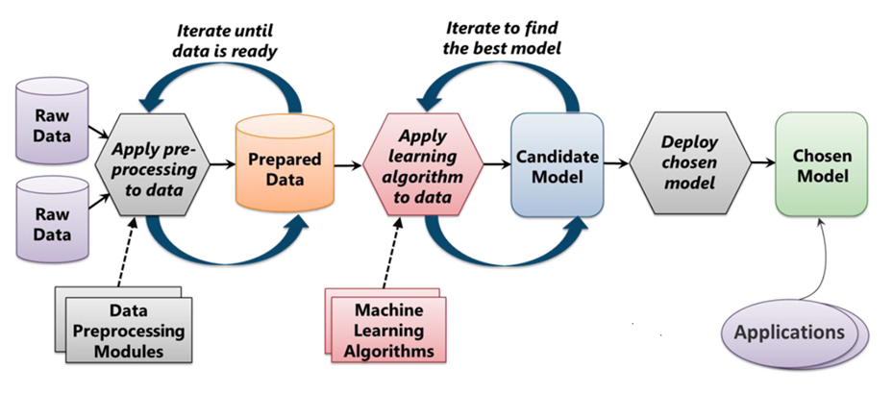
Data Science process
Extracting value from large amounts of data {and making human sense of it} is the primary challenge of data science
Find the data
Extract and acquire the data
Clean and transform the data
Understand the relationships in the data and build a model
Mine for additional data
Evaluate and refine the model
Communicate the results
From "Introduction to Microsoft Azure" by David Chappell

Slide 6
Predictive & Preemptive Analytics
Data
What should I do?
Decisions
Actions
What will happen?
Why did it happen?
What happened?
Manual process
Notes:
Notes:
Data science is evolving from simply trying to figure out what happened in the past to
Going deeper and discovering why it happened to
Predicting the future and figuring out what will happen
The final goal it to not only figure out what will happen but to make decisions preemptively and take actions automatically
References:
Microsoft: DATA203x Data Science and Machine Learning Essentials, edx.org

Slide 7
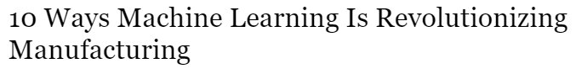
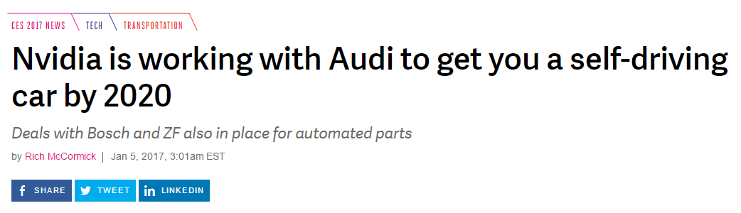

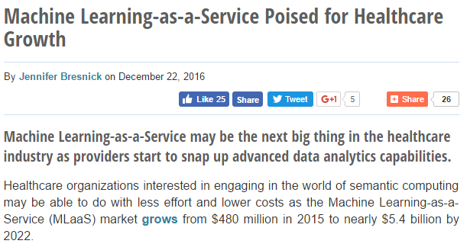
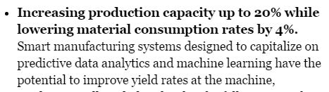
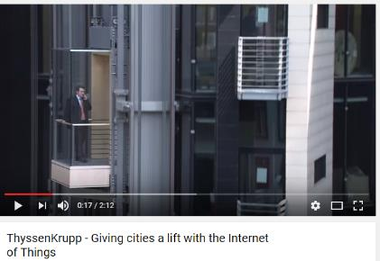
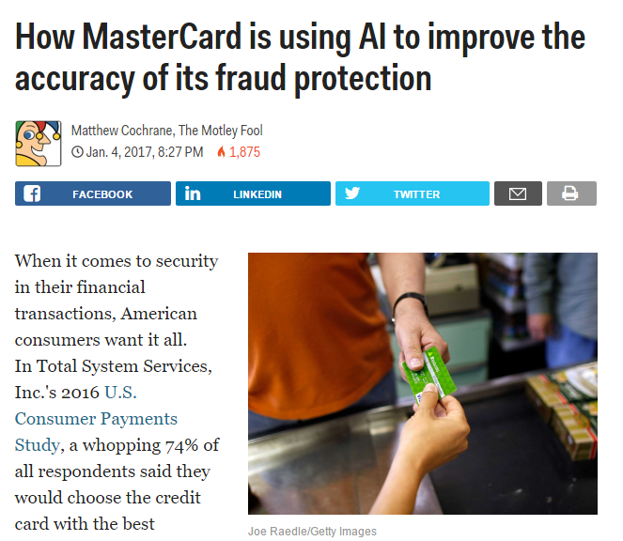
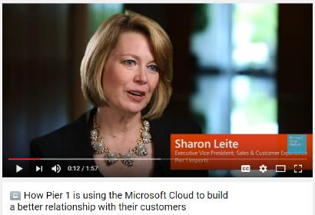
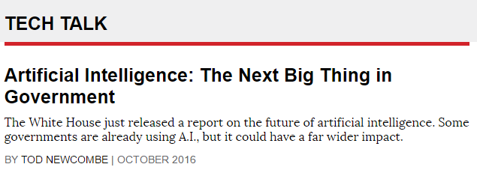
Scenarios with high stakes
Notes:
Notes:
Today, there are many use cases for Big Data analysis.
For example, Big Data is used to improve many aspects of our cities and countries. It allows cities to optimize traffic flows based on real-time traffic information, as well as social media and weather data.
In South Korea, the midnight bus route project utilized Big Data analysis to determine frequency of credit card use and taxis to determine where more public transportation was needed.
Industry
Scenario
Automotive
Self-driving cars. Energy efficiency.
Finance
Trading decisions and reduction of fraudulent transactions.
Government
Improving and optimizing services.
Health Care
Uncovering hidden insights to improve patient care and public health.
Manufacturing
Optimizing machine and device performance.
Retail
Customer relationship-building and product recommendations.

Slide 8




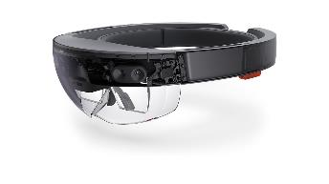



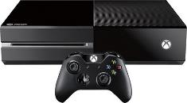

Applied Data Science @ Microsoft
Data {with customer permission} drives high-value experiences
Cortana {contextual understanding}
Bing {ranking, recommendations}
Windows 10 {Insider telemetry}
Windows Hello {next gen security}
Skype Translator {voice input}
HoloLens {object recognition}
Xbox {gamer matchmaking}
Microsoft Research {innovation}

Slide 9
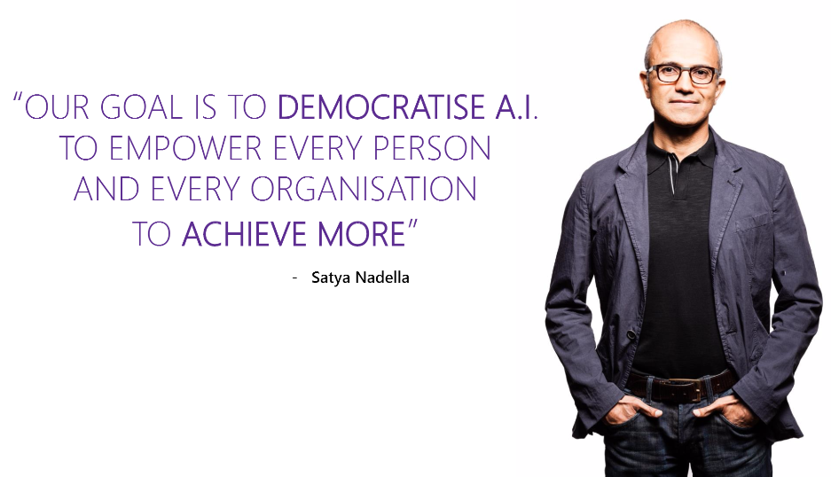
Microsoft’s cultural shift

Slide 10
Microsoft Linux

Slide 11


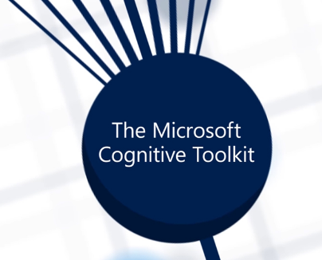
{Human} tools for every Creator, Builder, Coder, Scientist
I want to easily build or leverage learning models…
I want to build more intelligent experiences…
I want to build my own deep-learning models…

Slide 12
Machine Learning

Slide 13


What is Machine Learning?
Branch of computer science in which a computer "learns" from data in order to perform predictive analytics
Supervised Learning
Ground truth observations to:
Learn from a set of training data
Teach the algorithm to learn the mapping
Feature | Value
Name | Bill Gates
Age | 60
Gender | Male
Amount | $352.00
Purchased | Software
Location | Redmond, WA
Time | 3:15 p.m.
… | …
Unsupervised Learning
Learning from unlabeled observations
Discover latent patterns and structure
And end in of itself:
Exploratory data analysis
Discovery of hidden patterns
Notes:
Machine Learning finds patterns in large volumes of data and uses those patterns to perform predictive analysis. Microsoft offers Azure Machine Learning, while Amazon offers Amazon Machine Learning and Google offers the Google Prediction API. Software products such as MATLAB support traditional, non-cloud-based ML modeling.
Machine learning models fall into two broad categories: supervised and unsupervised. In supervised learning, the model is "trained" with a large volume of data and algorithms are then used to predict an outcome from future inputs. Most supervised learning models use regression algorithms to compute an outcome from a continuous set of possible outcomes (for example, your score on a test), or classification algorithms to compute the probability of an outcome from a finite set of possible outcomes (for example, the probability that an e-mail is spam or a credit-card transaction is fraudulent). In unsupervised learning, the computer isn't trained, but is presented with a set of data and challenged to find relationships in it. K-Means Clustering is a common unsupervised learning algorithm. For a great explanation of how it works, see https://blog.intercom.io/machine-learning-way-easier-than-it-looks/.

Slide 14

Machine Learning {Feature Vectorization}
Each observation is represented by a set of numbers.
Each pixel has a RGB value like [1.0, 1.1, 0.8]
Entire image is represented as [1.0, 1.1, 0.8, ………….]
Label = -1 or false (i.e., this image is not a chair)
Notes:
Notes:
Features must be represented by numbers in order to run the algorithm

Slide 15










Machine Learning {Classification}
Labeled Training Set
Test Set
Chair ?
chair
Not chair
Not chair
Not chair
Not chair
chair
Notes:
Notes:
Classification algorithms answer a binary question: generally yes/no.
Algorithm is provided with a training set labeled with ground truth observations.
Notice that the labels are “chair” or “not chair”; i.e., they are not labeled dog, car, etc.
Alternatively, items could be labeled with the specific names and the algorithm would simply convert these to “not chair”.
Notice that one item is really a chair but labeled incorrectly as “not chair”.
Data can have noise and errors, however, a small amount will not affect the overall effectiveness of the algorithm.
After running the machine-learning algorithm on the labeled training set, it must then be run on the test set to determine how accurate the algorithm is.

Slide 16
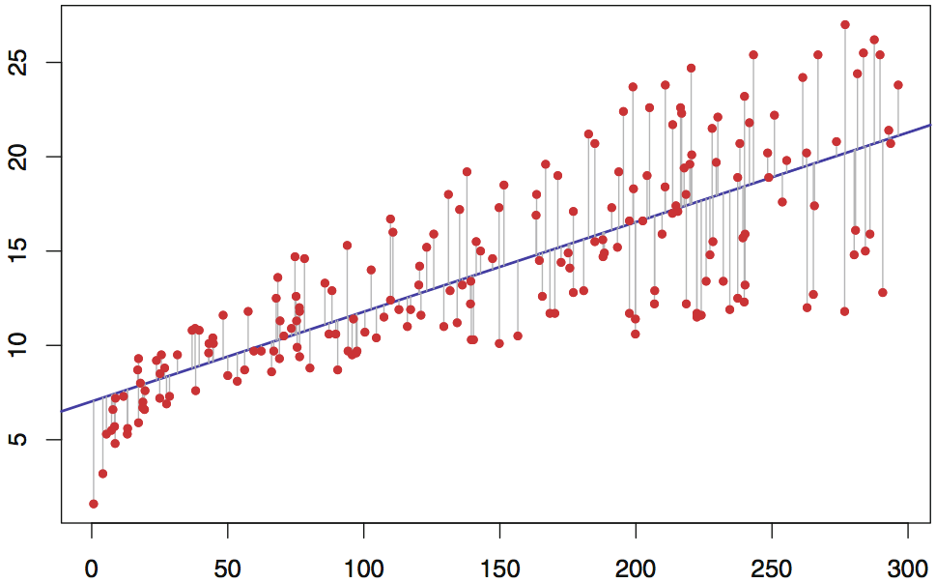
Machine Learning {Evaluation}
Univariate Linear Regression (Y = b₀ + b₁X where Y is the dependent variable)
Error between actual and computed output minimized using least-squares or gradient-descent method
Insight: Was this the best model? Should I build a better one?
Notes:
Linear regression has been around for hundreds of years and is widely used in statistical modeling. The simplest form of linear regression (univariate) has one input variable and one output variable. Various techniques are used to best-fit a line (hence, LINEAR regression) to the data. Multivariate linear regression is similar, but adds additional terms to the equation (b2, b3, and so on).
Training a linear regression model with millions of values can take time, but once the model is trained, using it to perform predictive analysis is fast because "running" the model involves little more than solving an equation whose coefficients have already been computed (during training). This illustration can be used to explain why picking the right algorithm is key to building an effective model. If there is not a relatively linear relationship between input variable(s) and output variable(s), then linear regression won't produce a robust predictive model.

Slide 17


I spent last semester building a regression model in Python, and I just did the same thing in 10 minutes with Azure ML
Notes:
This quote came from a graduate student who attended this class at UMass. He had already accepted at offer to go to work for Microsoft post-graduation. ☺

Slide 18
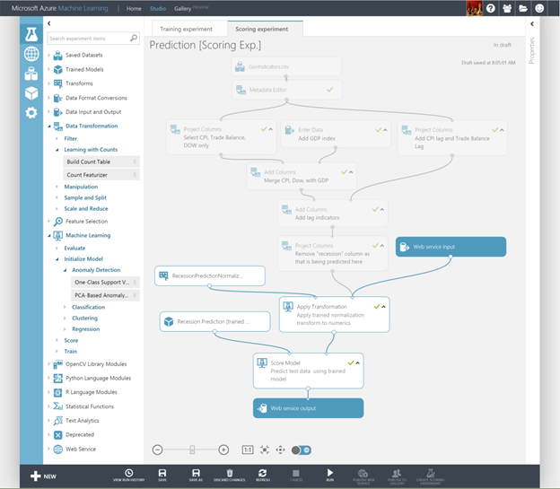
Azure ML Studio
Visual editor for composing, testing, refining, and deploying machine-learning models:
Numerous data input formats
Hundreds of pre-built modules:
Common algorithms for classification, regression, and evaluation
R and Python scripting
No coding necessary; SaaS with PaaS extensibility
Notes:
ML Studio simplifies machine learning by providing a drag-and-drop model in which you build workflow. With ML Studio and the rich of assortment of modules it offers for modeling workflow, you can often build sophisticated models without writing a single line of code. However, it allows you to insert R and Python code anywhere in the workflow, providing infinite flexibility in what you can model.

Slide 19
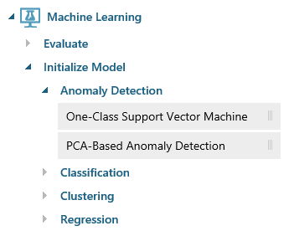
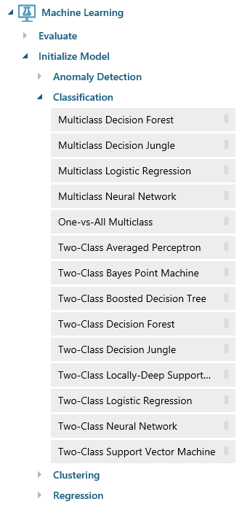
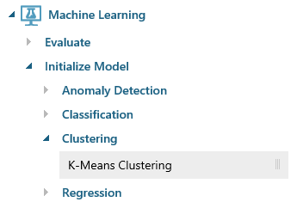
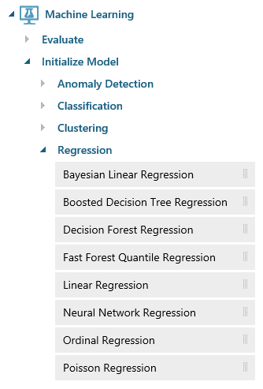
Algorithms-in-a-Box
Notes:
ML Studio provides canned implementations of 25 of the classic algorithms used in machine learning. It divides them into four categories.
Anomaly detection is the identification of items, events, or observations which do not conform to an expected pattern or other items in a dataset. A classic example is examining a dataset representing banking transactions and detecting potentially fraudulent transactions in that group.
Regression algorithms seek to establish and quantify relationships between variables. By establishing a relationship between a dependent variable and one or more independent variables, regression analysis can enable the value of a dependent variable to be predicted given a set of inputs with a quantifiable accuracy. A great example can be seen at https://how-old.net/#, a site that lets you upload a photo and then guesses your age with uncanny accuracy. The site uses Azure Machine Learning and combines classic regression with advanced image recognition.
The purpose of classification algorithms is to identify the category to which an observation belongs based on training data consisting of observations which have already been classified (assigned to a category). A great example is determining whether an e-mail belongs to the "spam" category or the "not-spam" category.
Clustering seeks to group a set of objects in such a way that objects in the same group (called a cluster) are more similar to each other than to those in other groups (clusters).

Slide 20
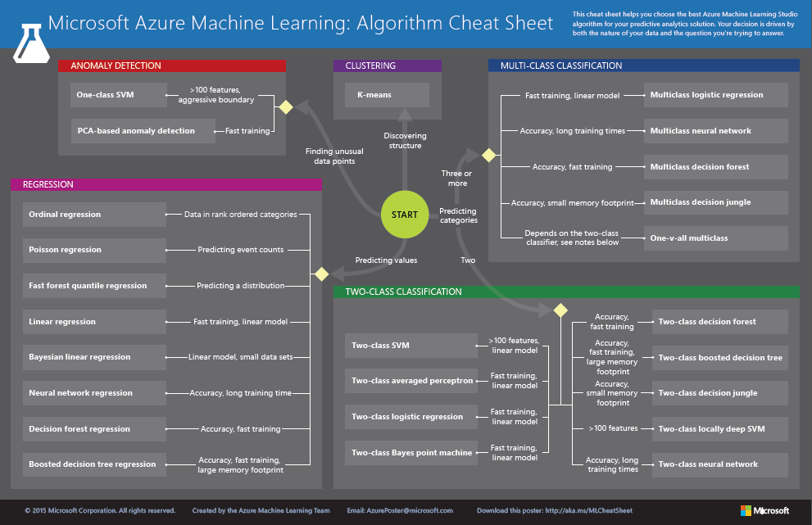
http://aka.ms/MLCheatSheet
Notes:
The Azure ML Cheat Sheet helps you pick the right algorithm for a model, even if you're not a trained data scientist. One example is if you want to use a set of input values to predict an output value from a continuous set of values (e.g., a person's age), use linear regression. But if you're more interested in the distribution of the output, you might use fast forest quantile regression instead. An example of when you would use the latter is using growth charts to assess child development. "Abby's height is in the 10% quantile of the heights of kids her age." Classification algorithms, by contrast, are used to predict a value from a discrete set of values -- for example, classifying an e-mail as spam or not spam.

Slide 21
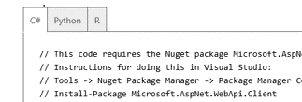
Deploy to Web Service
Data
Clients
ML STUDIO
API
Model is now a web service that is callable
Blobs and Tables
Hadoop (HDInsight)
Relational DB (Azure SQL DB)
Integrated development environment for Machine Learning
Monetize the API through our marketplace
Notes:
Linear regression has been around for hundreds of years and is widely used in statistical modeling. The simplest form of linear regression (univariate) has one input variable and one output variable. Various techniques are used to best-fit a line (hence, LINEAR regression) to the data. Multivariate linear regression is similar, but adds additional terms to the equation (b2, b3, and so on).
Training a linear regression model with millions of values can take time, but once the model is trained, using it to perform predictive analysis is fast because "running" the model involves little more than solving an equation whose coefficients have already been computed (during training). This illustration can be used to explain why picking the right algorithm is key to building an effective model. If there is not a relatively linear relationship between input variable(s) and output variable(s), then linear regression won't produce a robust predictive model.

Slide 22
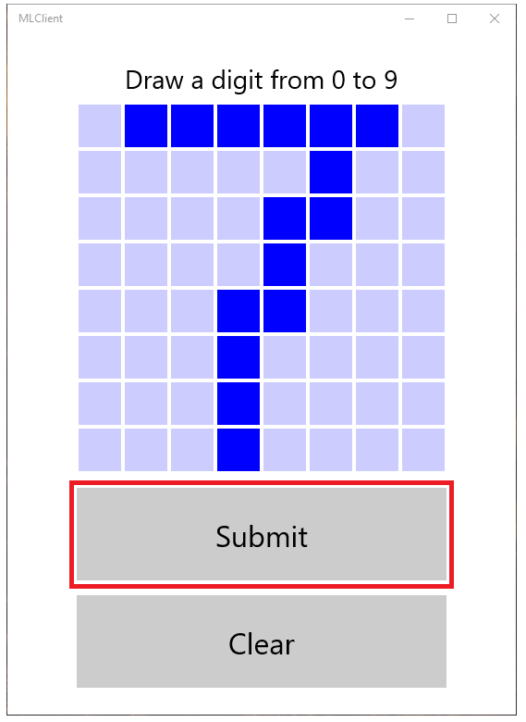
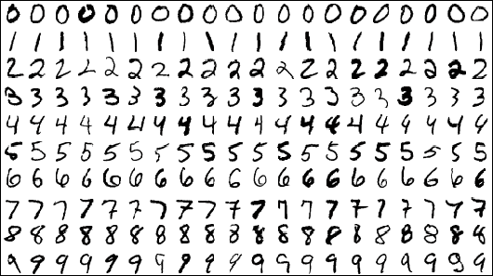
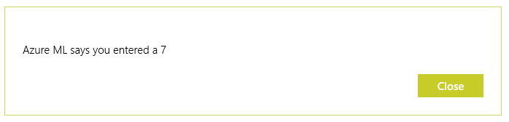
Demo: Handwriting recognition lab
MNIST dataset which consists of 70,000 grayscale
images of hand-written digits {28x28px}
http://aka.ms/azureMLLab
Notes:
Once deployed as a Web service, a model can be used with simple REST calls over HTTP. This enables developers to build "smart apps" that get their intelligence from ML. In the next lab, students will build and train an ML model, deploy it as a Web service, and then write a client app that uses it.

Slide 23
Cognitive Services

Slide 24
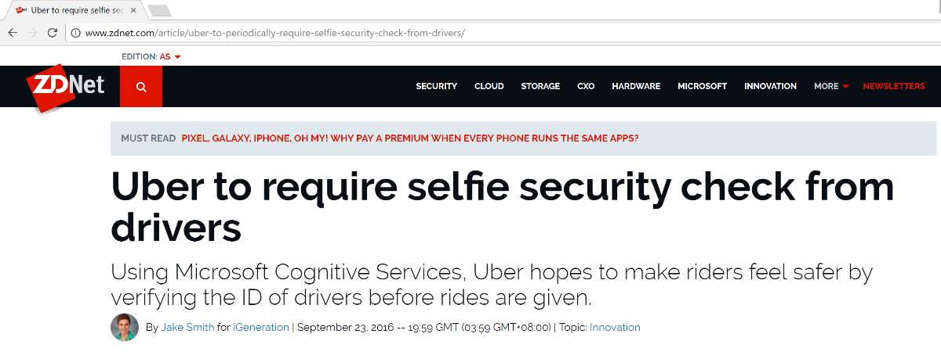


So you don’t want to build your own models…
https://www.youtube.com/watch?v=aEBi4OpXU4Q
Notes:
Microsoft Cognitive Services is a set of intelligent APIs for building equally intelligent applications. It currently offers 21 different API for analyzing images, videos, text, and much more. For more information, visit https://www.microsoft.com/cognitive-services.

Slide 25
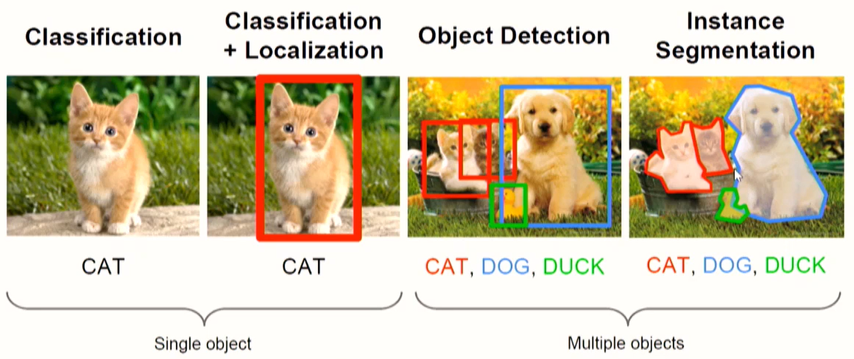
Computer Vision Tasks

Slide 26
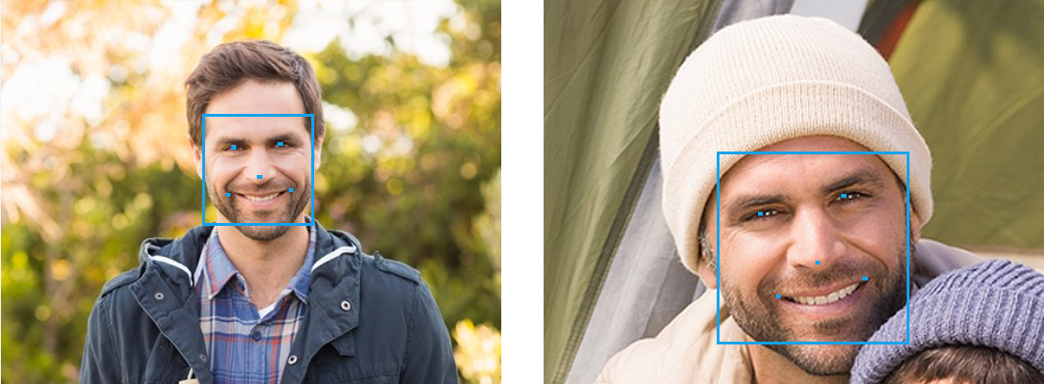
Identify & Analyze Faces
Use the Cognitive Services Face API to compare
faces, identify faces, search for similar faces, and more
Notes:
The Microsoft Cognitive Services Face API (https://www.microsoft.com/cognitive-services/en-us/face-api) includes methods for detecting human faces, comparing faces for similarity, organizing people into groups according to visual similarity, identifying people previously tagged people in images, and more. It is one of more than 20 APIs in the Cognitive Services family that enable developers to build intelligent apps by embedding functionality that is the product of years of research.

Slide 27
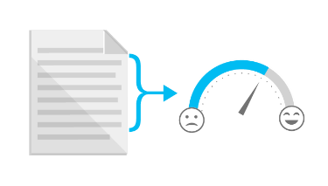

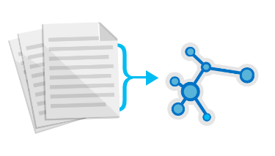

Sentiment Analysis
Use the Cognitive Services Text Analytics API
to analyze sentiment in text files, Twitter feeds, and other sources
Sentiment Analysis
Key Phrase Extraction
Topic Detection
Language Detection
“Thanks to Text Analytics…we are able to incorporate guest sentiment into our actionable guest feedback platform that delivers a comprehensive view of guest satisfaction and server performance.”
— Al Pappa, Head of Business Intelligence, Ziosk
Notes:
The Microsoft Cognitive Services Text Analytics API (https://www.microsoft.com/cognitive-services/en-us/text-analytics-api) includes methods for sentiment analysis, key-phrase extraction, topic detection, and language detection. The sentiment-analysis API accepts text as input and returns a numeric score between 0 and 1. Scores close to 1 indicate positive sentiment and scores close to 0 indicate negative sentiment. Sentiment score is generated using classification techniques. The input features of the classifier include n-grams, features generated from part-of-speech tags, and word embeddings. Currently, English, French, Spanish, and Portuguese text are supported.

Slide 28
Cognitive Services API Set
Vision
Computer Vision
Emotion
Face
Video
Speech
Bing Speech
Custom Recognition
Speaker Recognition
Language
Bing Spell Check
Language Understanding
Linguistic Analysis
Text Analytics
Web Language Model
Knowledge
Academic Knowledge
Entity Linking
Knowledge Exploration
Recom-mendations
Search
Bing Auto-suggest
Bing Image Search
Bing News Search
Bing Video Search
Bing Web Search
Notes:
Microsoft Cognitive Services is a set of intelligent APIs for building equally intelligent applications. It currently offers 21 different API for analyzing images, videos, text, and much more. For more information, visit https://www.microsoft.com/cognitive-services.

Slide 29
Demo: Computer Vision API
https://www.microsoft.com/cognitive-services/en-us/computer-vision-api

Slide 30







build something fun
“Welcome your friends; know your foes.”
4
Photo is taken
5
Face is analyzed
3
Alarm is sounded
Full tutorial on hackster.IO
1
Person enters room
2
Motion is detected
6a
Recognized person is welcomed
6b
Image of unrecognized person is sent to mobile app
Notes:
Here is an example of adding intelligence to your project. Dorm Room Monitor is a “smart” security system. What makes it “smart”? It utilizes facial recognition to distinguish between people who are approved to be there and those that aren't; if the person is recognized by the security system, he or she is welcomed into the room. If the person isn't recognized, a photo of the intruder is stored in the system for the room owner to review later.
(Now, demo the actual project you built live.)

Slide 31
Microsoft Cognitive Toolkit

Slide 32
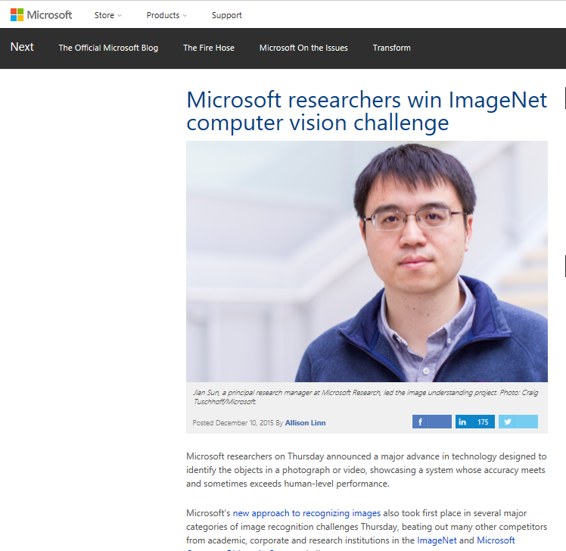
ImageNet: Microsoft 2015 ResNet
Notes:
Microsoft had all 5 entries being the 1st places this year: ImageNet classification, ImageNet localization, ImageNet detection, COCO detection, and COCO segmentation

Slide 33



Cognitive toolkit (CNTK)
Microsoft’s fully open source, deep-learning toolkit
Speed & scalability {while maintaining accuracy}
Commercial-grade AI {used in Cortana & Bing}
Familiar {use Python on Linux or Windows}
C#, R, Spark, Docker, and other open source coming soon
iOS / Android runtime later in 2017…
Notes:
CNTK expresses (nearly) arbitrary neural networks by composing simple building blocks into complex computational networks, supporting relevant network types and applications.
CNTK is production-ready: State-of-the-art accuracy, efficient, and scales to multi-GPU/multi-server.
Lego-like composability allows CNTK to support a wide range of networks, e.g.
feed-forward DNN
RNN, LSTM, GRU
convolution
DSSM
sequence-to-sequence
for a range of applications including
speech
vision
text
and combinations
Large data sets is the key here; performant
Microsoft’s open-source deep-learning toolkit
Ease of use: what, not how
Fast
Flexible
First class on Linux and Windows
No internal Microsoft version; it’s open, no really

Slide 34
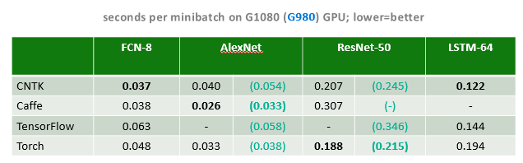
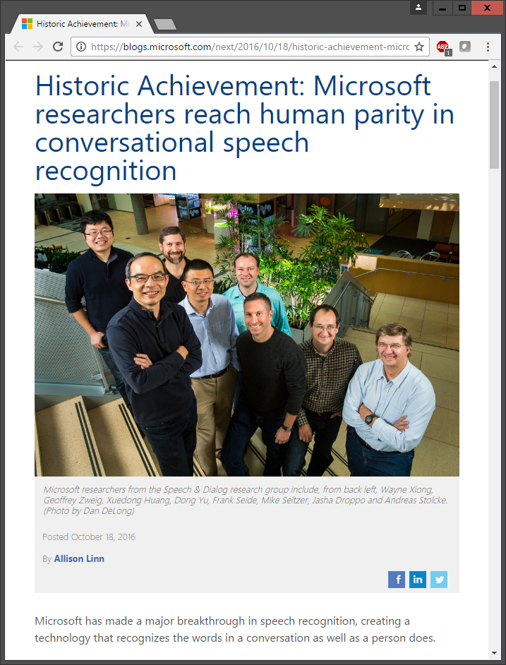
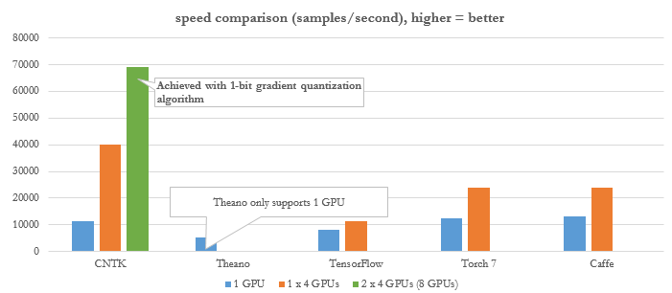
Highly scalable, Production ready
Notes:
CNTK comparable on single server, significant performance on multi-server

Slide 35
Performance: Variable-Length Sequences
minibatches containing sequences of different lengths are automatically packed and padded
speed-up is automatic:
time steps computed in parallel
sequence 1
sequence 2
sequence 3
padding
parallel sequences
sequence 4
sequence 7
sequence 5
sequence 6
Notes:
Recurrent nueral networks

Slide 36
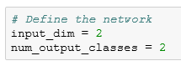
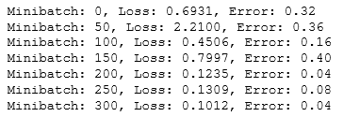
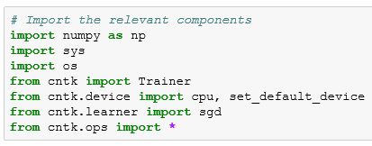
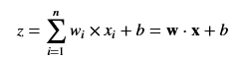
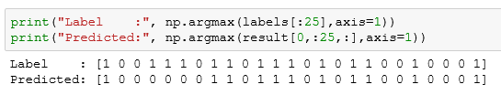
Breaking-down CNTK
Python script configures and executes…
reader
• minibatch source • task-specific deserializer
• automatic randomization
• distributed reading
network
• model function • criterion function • CPU/GPU execution engine
• packing, padding
trainer
• SGD
• Minibatching
cntk
model
Example: binary classification
https://notebooks.azure.com/n/1zbIwzaANic/notebooks/CNTK_101_LogisticRegression.ipynb
Notes:
Configure reader, network, learner
Train & evaluate (multi-phase for layer building)
Deploy offline from Python

Slide 37
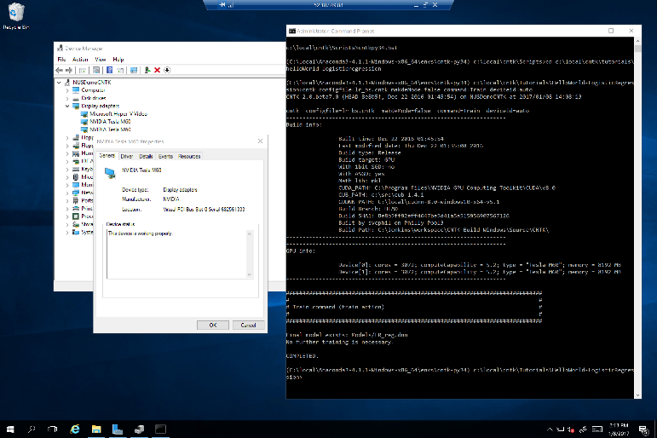
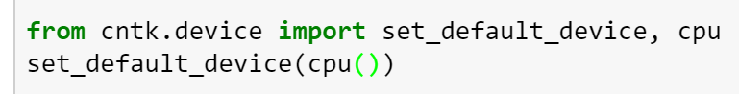
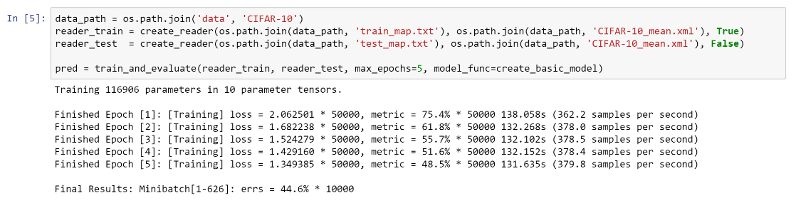
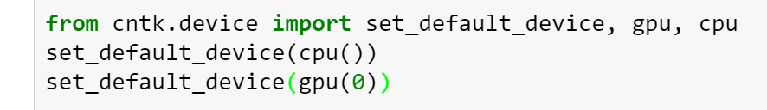
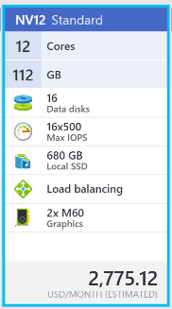
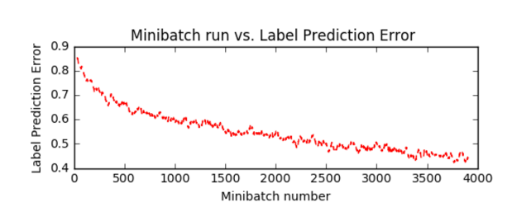
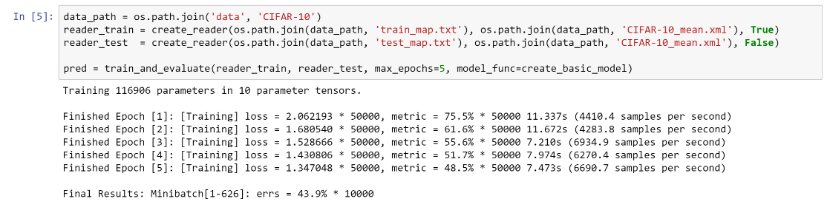
Demo: CNTK scale with Azure N-series VM
…CPU set only
…with GPU set

Slide 38
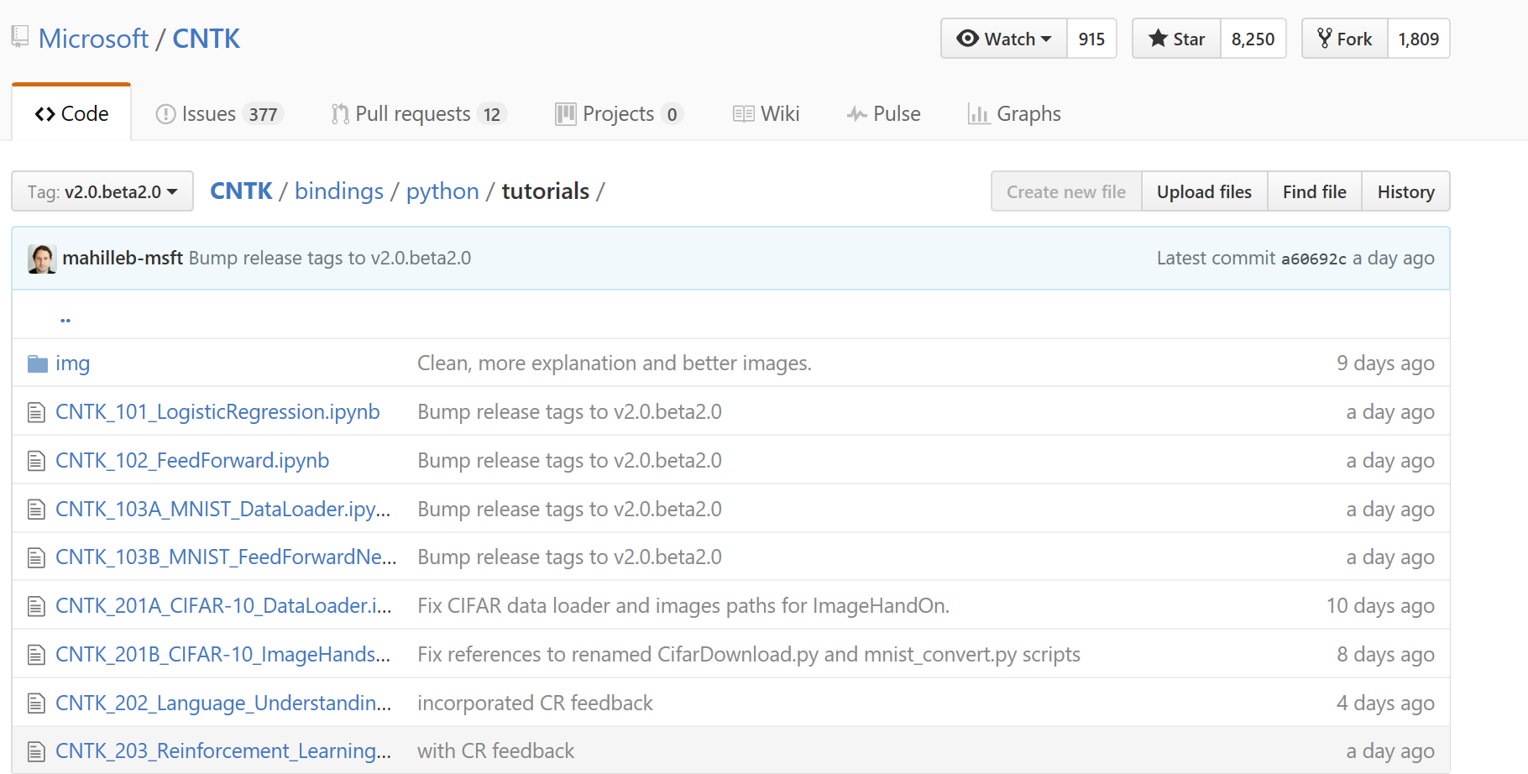
How to get started with CNTK
Binaries & Tutorials
https://github.com/Microsoft/CNTK/wiki
Deep-learning VM Toolkit https://azure.microsoft.com/en-us/marketplace/partners/microsoft-ads/dsvm-deep-learningtoolkit/
Deep-dive lecture & labs
https://www.youtube.com/watch?v=pl-kbFJ1KzU
Team Q&A
http://stackoverflow.com/questions/tagged/cntk

Slide 39

Where to go from here…
Tame your data. Try {more human} data tools.
Consider MPP Data Science credential
Enter Imagine Cup {$100K cash prize}

